Slide 1
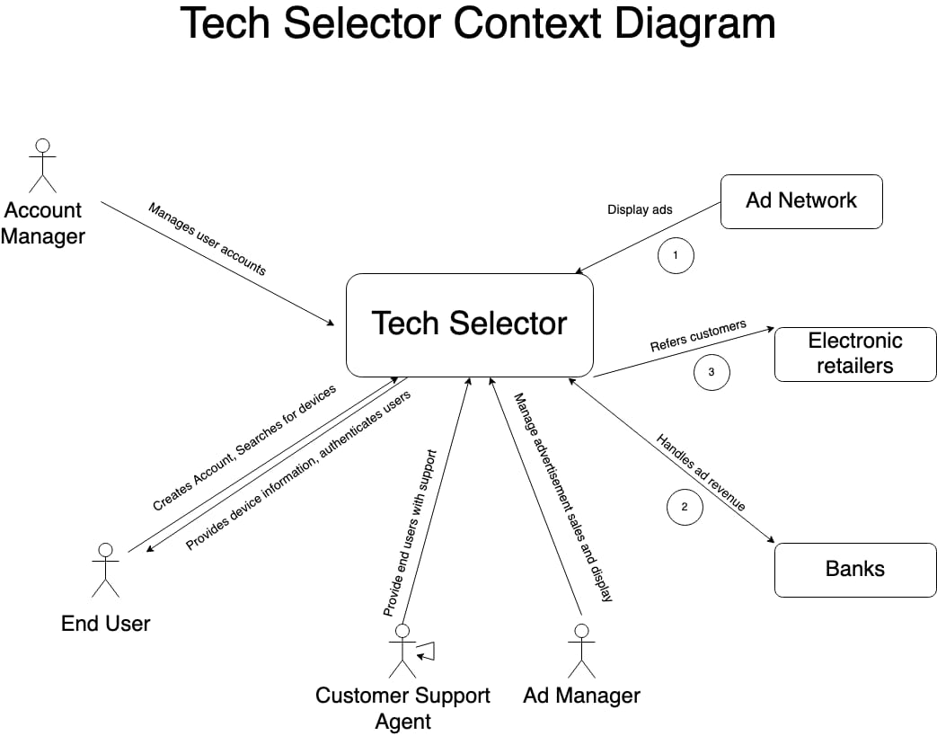


Slide 2
System Interface Table
No | Description | Source | Target | Frequency | Validation
1 | Display Ads | Ad Network | Tech Selector | Real-time | Displays advertises regarding different products.
2 | Refers customers | Tech Selector | Electronic Retailers | Real-time | Redirect Customer to the website where they can find best deals for their products.
3 | Handles ad Revenue | Banks | Tech Selector | Real-time | Revenue Generated will be taken care by the banks.

Slide 3
Revision Notes
Added a new point “Display Ads” to the System Interface Table.
Removed point number 1 “Provide Device Information” from the System Interface Table.
Removed point number 2 “Provide Review Score” from the System Interface Table.

